Slide 1
Network Congestion Control

Slide 2
Session Objectives
After completion of the session you will be able to understand
Concept of Network Traffic Congestion
Congestion Control Policies
Congestion Control Approaches

Slide 3

Introduction
The main focus of congestion control and quality of service is data traffic.
In congestion control we try to avoid traffic congestion.
In quality of service, we try to create an appropriate environment for the traffic.
Traffic descriptors

Slide 4

Network Traffic Pattern

Slide 5

Network Congestion
Congestion in a network may occur if the load on the network—the number of packets sent to the network—is greater than the capacity of the network—the number of packets a network can handle.
Congestion control refers to the mechanisms and techniques to control the congestion and keep the load below the capacity.

Slide 6
Congestion Control
Congestion control refers to techniques and mechanisms that can either prevent congestion, before it happens, or remove congestion, after it has happened.
In general, we can divide congestion control mechanisms into two broad categories: open-loop congestion control (prevention) and closed-loop congestion control (removal).
The open-loop congestion control policies are used to prevent the congestion before it happens.
In open-loop Congestion control is handled either by the source or by the destination.
In closed loop congestion control mechanisms the congestion is removed after it had happens.

Slide 7

Congestion Control Approaches

Slide 8
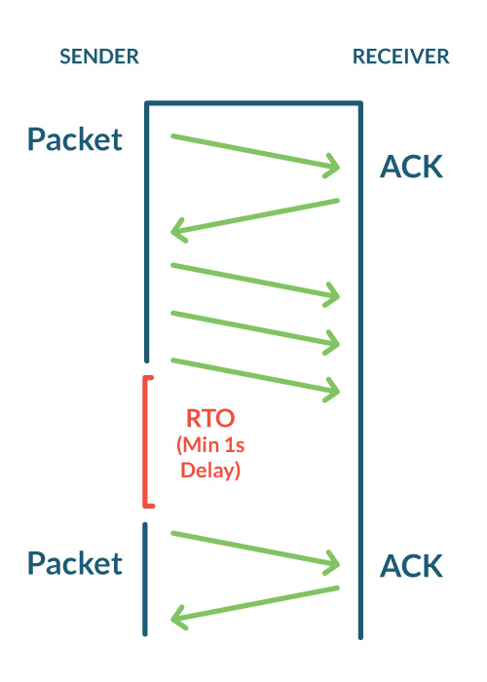
Open-loop congestion control policies
Retransmission Policy
• The sender retransmits a packet, if it feels that the packet it has sent is lost or corrupted.
• However retransmission in general may increase the congestion in the network. But we need to implement good retransmission policy to prevent congestion.
• The retransmission policy and the retransmission timers need to be designed to optimize efficiency and at the same time prevent the congestion.

Slide 9
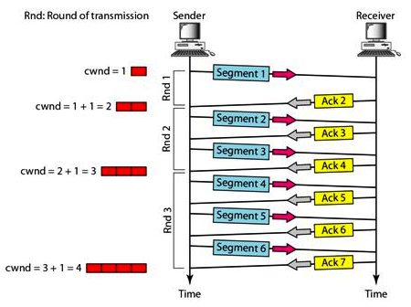
Contd….
Window Policy
• To implement window policy, selective reject/repeat window method is used for congestion control.
• Selective Reject method is preferred over Go-back-n window as in Go-back-n method, when timer for a packet times out, several packets are resent, although some may have arrived safely at the receiver. Thus, this duplication may make congestion worse.
• Selective reject/repeat method sends only the specific lost or damaged packets.

Slide 10
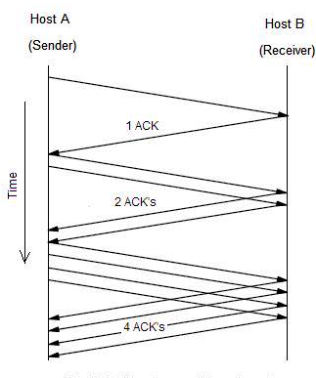
Contd….
Acknowledgement Policy
• The acknowledgement policy imposed by the receiver may also affect congestion.
• If the receiver does not acknowledge every packet it receives it may slow down the sender and help prevent congestion.
• Acknowledgments also add to the traffic load on the network. Thus, by sending fewer acknowledgements we can reduce load on the network.
• To implement it, several approaches can be used by a receiver:
    Acknowledge only if it has a packet to be sent.
    May send an acknowledgement when a timer expires.
    Acknowledge only N packets at a time.

Slide 11
Contd….
Discarding Policy
• A router may discard less sensitive packets when congestion is likely to happen.
• Such a discarding policy may prevent congestion and at the same time may not harm the integrity of the transmission.
Admission Policy
• An admission policy, which is a quality-of-service mechanism, can also prevent congestion in virtual circuit networks.
• Switches in a flow first check the resource requirement of a flow before admitting it to the network.
• A router can deny establishing a virtual circuit connection if there is congestion in the "network or if there is a possibility of future congestion.

Slide 12
Closed-loop congestion control policies
Backpressure
• Backpressure is a node-to-node congestion control that starts with a node and propagates, in the opposite direction of data flow.
• The backpressure technique can be applied only to virtual circuit networks. In such virtual circuit each node knows the upstream node from which a data flow is coming.
• Here, the congested node stops receiving data from the immediate upstream node or nodes. This may cause the upstream node on nodes to become congested, and they, in turn, reject data from their upstream node or nodes.

Slide 13

Backpressure Contd….
As shown in fig node III is congested and it stops receiving packets and informs its upstream node II to slow down. Node II in turns may be congested and informs node I to slow down. Now node I may create congestion and informs the source node to slow down. In this way the congestion is alleviated. Thus, the pressure on node III is moved backward to the source to remove the congestion.

Slide 14

Contd….
Choke Packet Method
• In this method of congestion control, congested router or node sends a special type of packet called choke packet to the source to inform it about the congestion.
• Here, congested node does not inform its upstream node about the congestion as in backpressure method.
• In choke packet method, congested node sends a warning directly to the source station i.e. the intermediate nodes through which the packet has travelled are not warned.

Slide 15
Contd….
Implicit Signaling
• In implicit signaling, there is no communication between the congested node or nodes and the source.
• The source guesses that there is congestion somewhere in the network when it does not receive any acknowledgment. Therefore the delay in receiving an acknowledgment is interpreted as congestion in the network.
• On sensing this congestion, the source slows down.
• This type of congestion control policy is used by TCP.

Slide 16
Contd….
Explicit Signalling
• In this method, the congested nodes explicitly send a signal to the source or destination to inform about the congestion.
Explicit signalling is different from the choke packet method. In choke packed method, a separate packet is used for this purpose whereas in explicit signalling method, the signal is included in the packets that carry data .
Explicit signalling can occur in either the forward direction or the backward direction
In backward signalling, a bit is set in a packet moving in the direction opposite to the congestion. This bit warns the source about the congestion and informs the source to slow down.

Slide 17
Summary
In this session we have learned
Network Congestion
Open-loop congestion control policies
Closed-loop congestion control policies

Slide 18

Notes:
1.#

